Slide 1
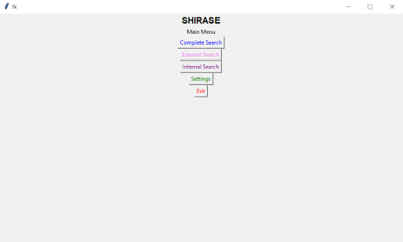
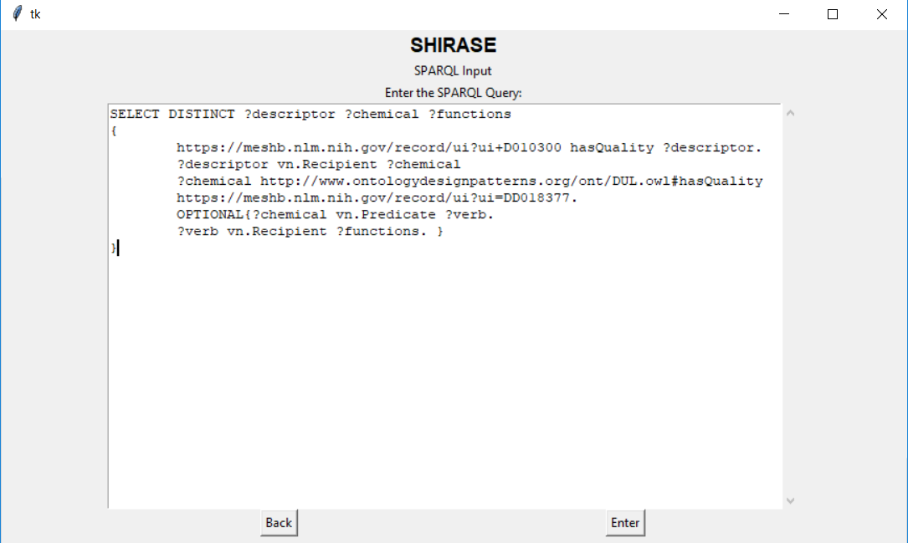
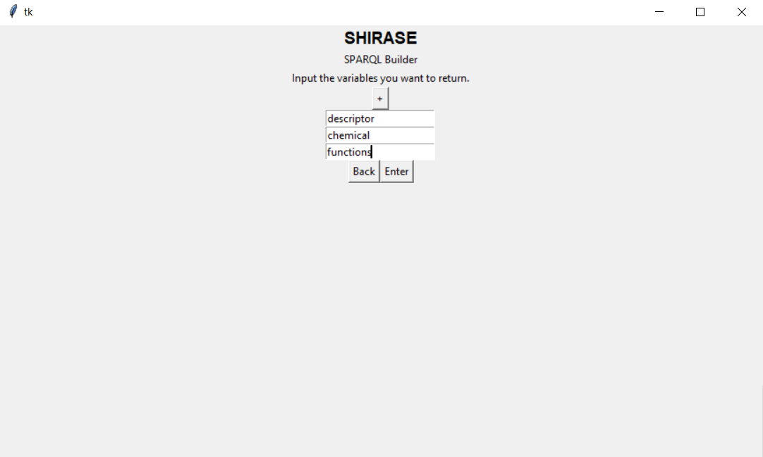
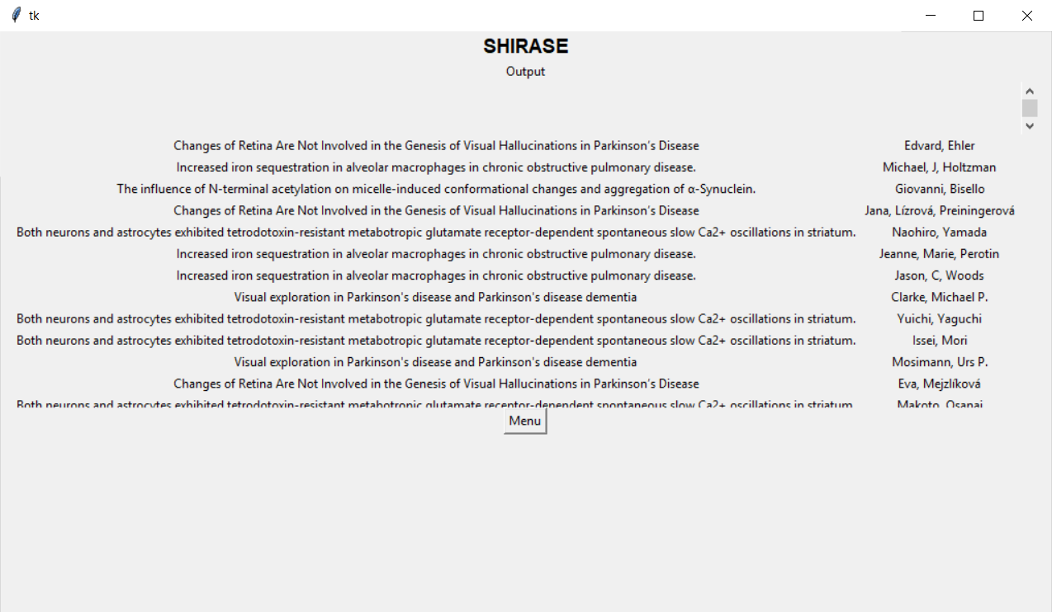
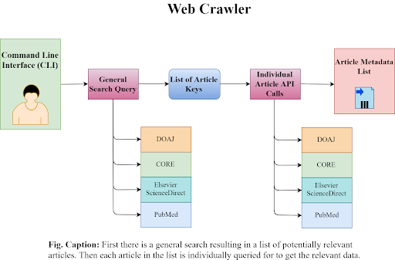
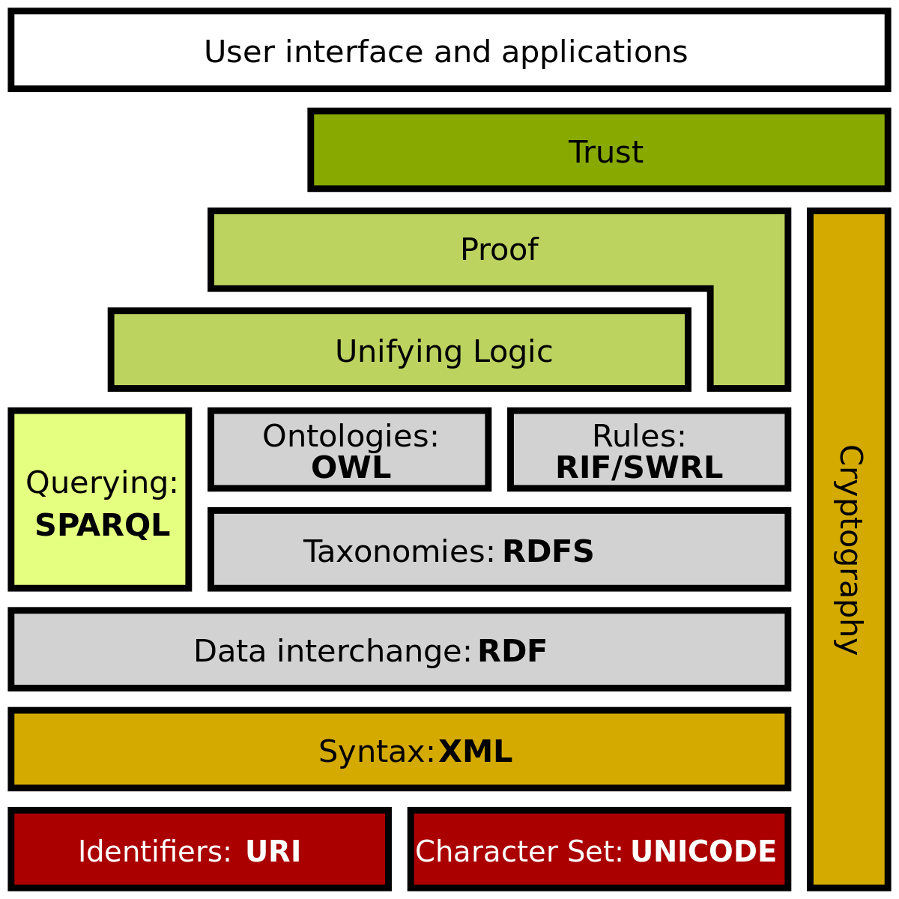
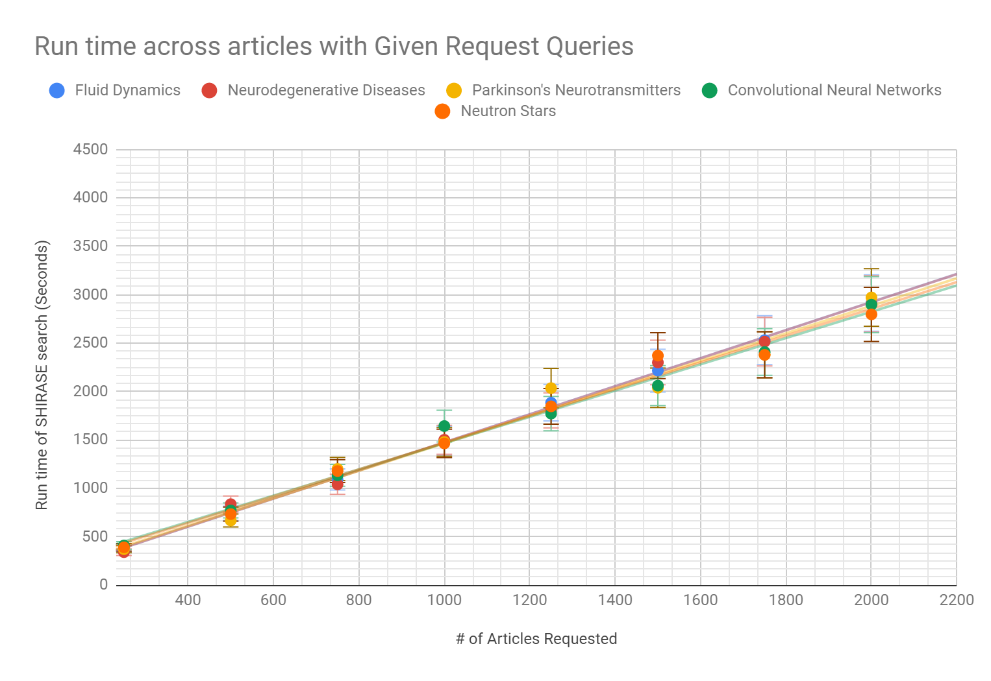
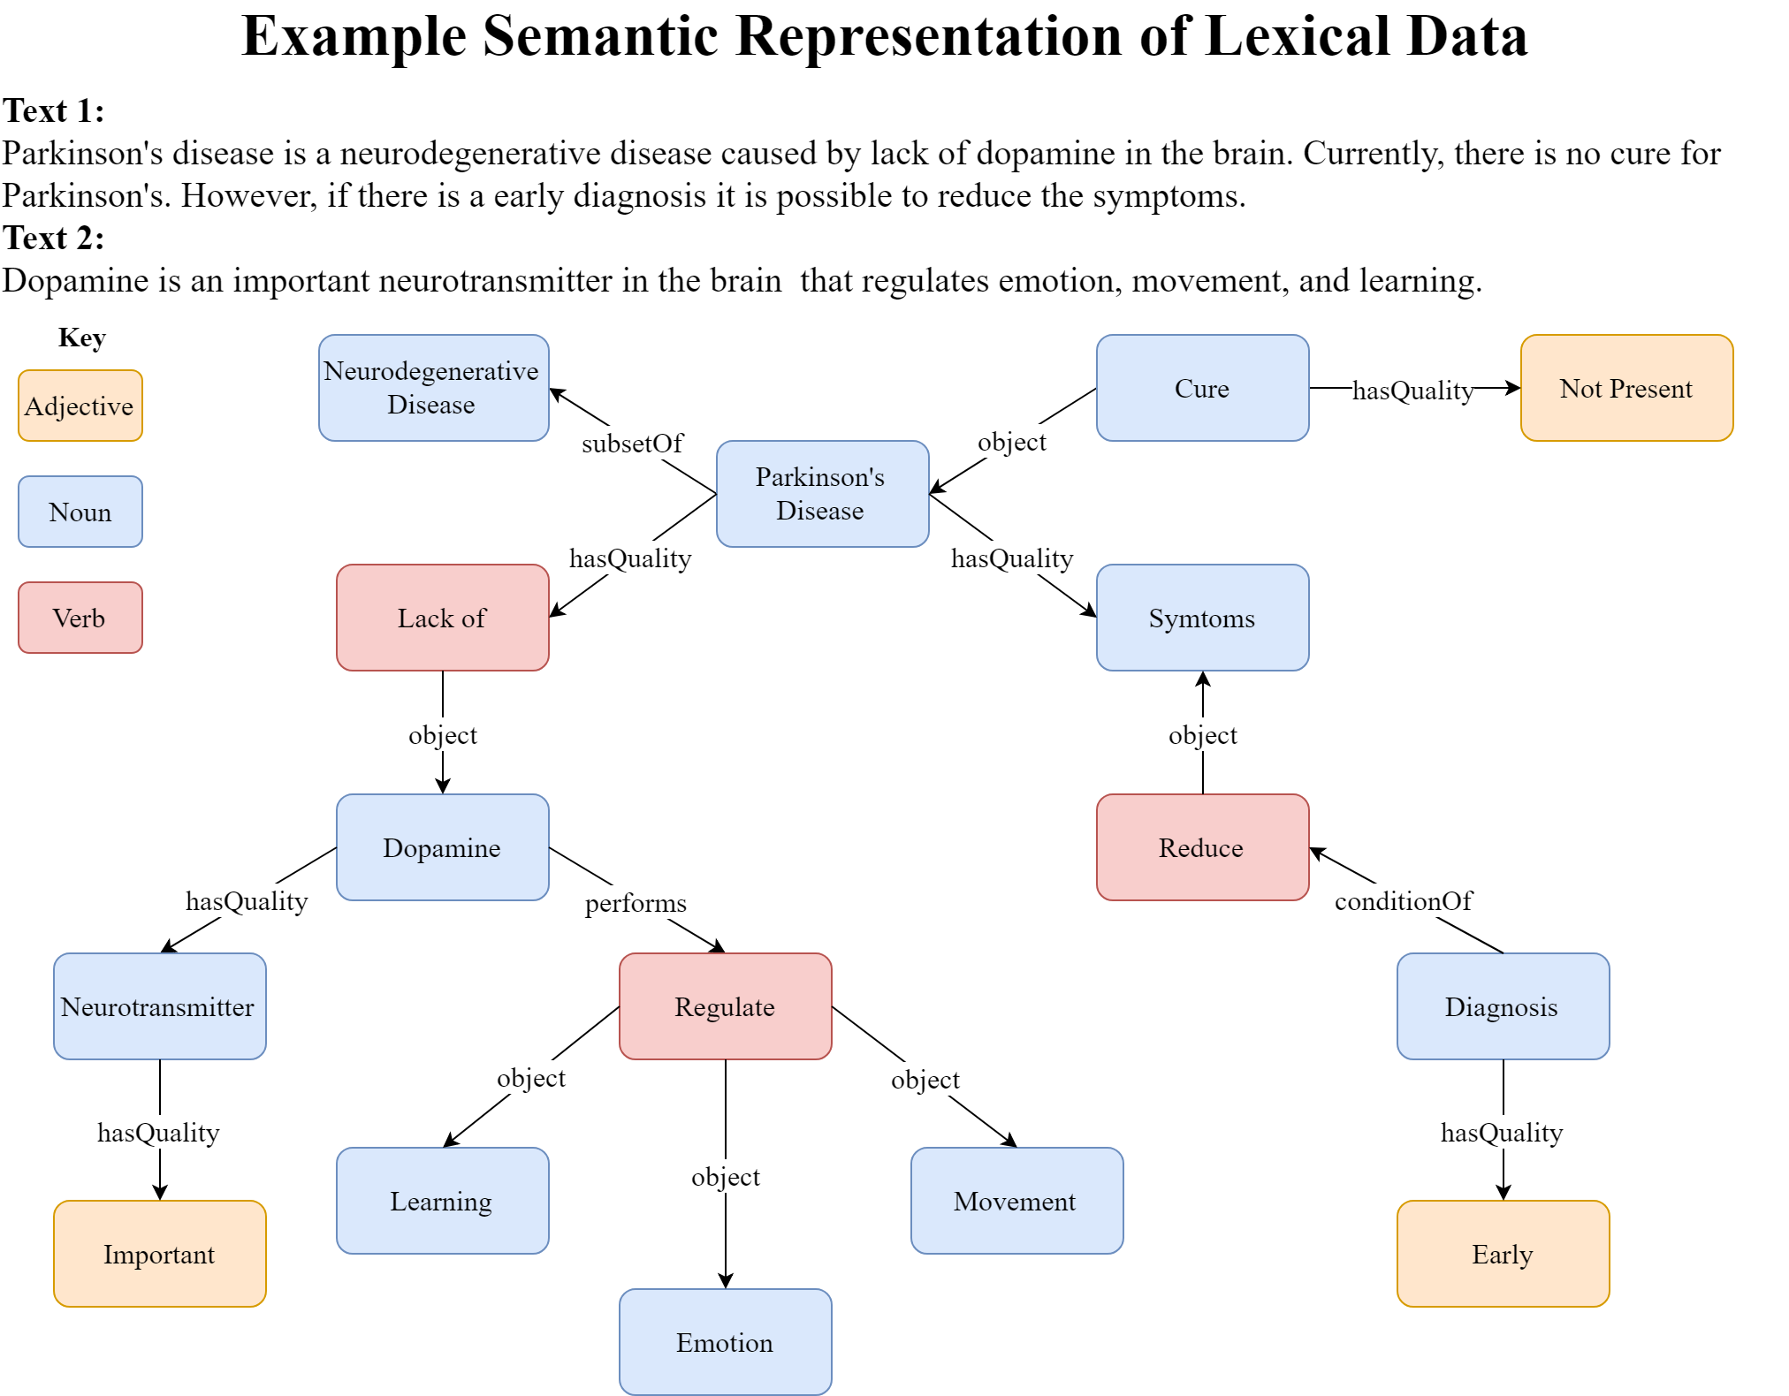
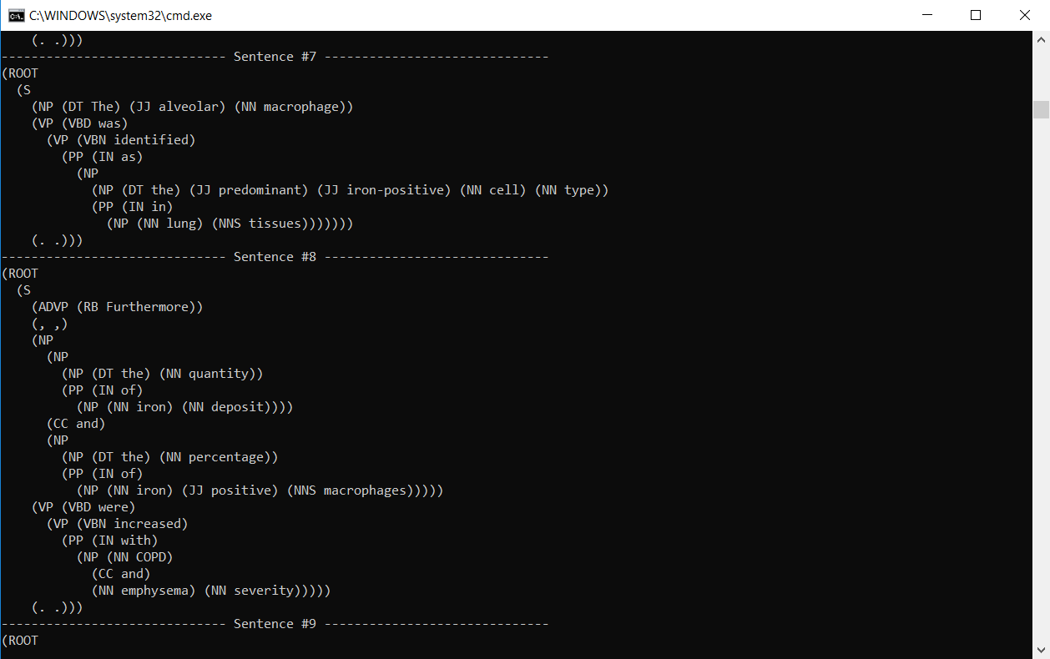
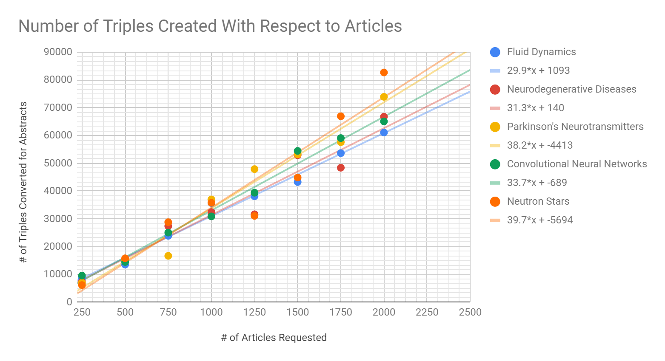
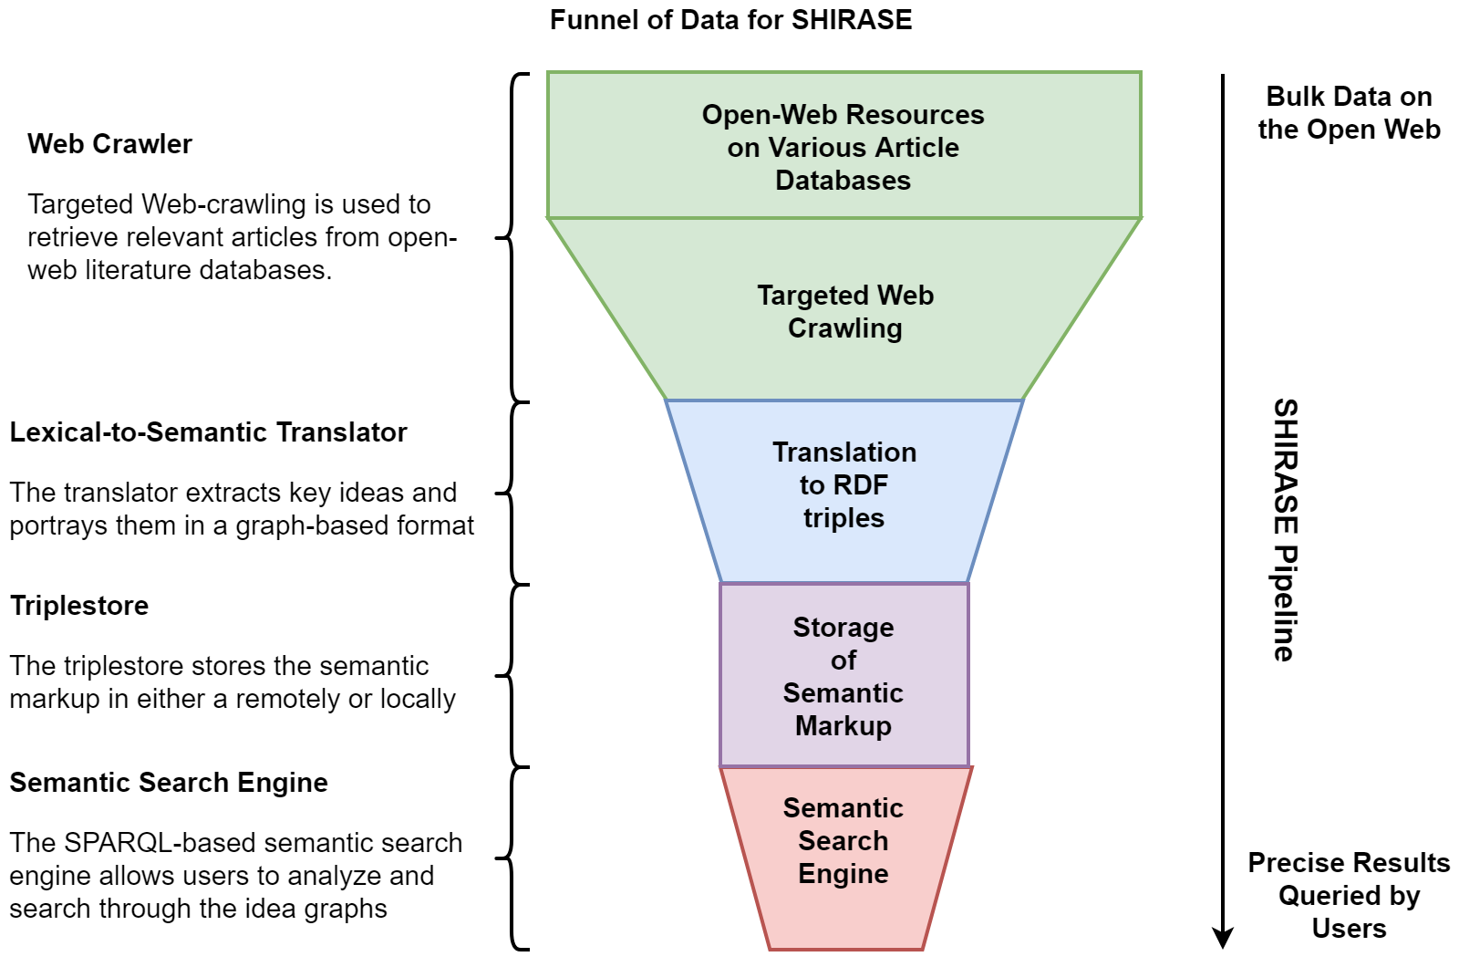
Project Overview
Generation and Analysis of Semantic Metadata Records Based on the Targeted Retrieval of Open-Web Resources for an Automated Article Search Engine Agent
Results and Conclusions
Introduction and Purpose
GUI
Here we introduce SHIRASE, a hybrid lexical-semantic article search engine. SHIRASE(Semantic-lexical Hybrid Information Retrieval And Search Engine) is designed to act as a utility that can utilize the versatility and specificity of a semantic search to access the breadth of data available on the conventional lexical web, thereby combining the best of both world. This allows SHIRASE to provide a far more fine-grained and nuanced search experience than conventional search engines.
Standard search engines (Google, Bing, DuckDuckGo) are all at their core lexically based. This means that instead of being based around the meaning of the data they are processing, it is based around the words (syntactic structure) through which the information is conveyed through. This means that these search engines are inflexible in the types of outputs they can give, unable to interpolate information from multiple sources, and unable to handle complex queries.
Through the use of formal semantics, SHIRASE is able to “understand” the data is processing by utilizing a data format which explicitly represents the ideas of a given article in a network form. This allows SHIRASE to present the a fine-grained and nuanced search solution which directly answer user queries (not just output web pages which are relevant to the query), utilize data from multiple sources to formulate a response, and handle extremely advanced and complex search queries.
In its current form, SHIRASE is designed as a knowledge search utility specifically for scientific material, however SHIRASE’s architecture is inherently expandable and can eventually made in a general search engine for the public.
Title Screen: There are various search options available to users to choose.
SPARQL Options: Can choose whether or not to use SPARQL builder form.
Methods and Components
SPARQL Direct Input: User can directly input raw SPARQL query into SHIRASE.
Condition Input: User inputs the conditions they want for the SPARQL query.
SHIRASE Framework
Lexical Web
External Search: Search online for resources to add to the SHIRASE database.
Output Choice: User chooses output variables for the SPARQL query
Currently, the internet is heavily lexically based. This means that it is based on the syntactic structure of words in a particular document rather than the meaning of the information being stored on the document itself. On an implementation level, this translates to data being stored on the web in such a way that computers, unless they use a form of metadata attached to an article (i.e. tags, categories, keywords, etc.), cannot understand the data that they are accessing. Because of this, search systems have to depend on the lexical structure of the data to interpret the articles that the user wants to retrieve, thus leading to the prevalence of keyword matching search engines which attempt to match phrases or words from a user’s query with key phrases or words from a particular web page of interest. Though these can be effective in interpreting the intent of a user in many scenarios, it is still nevertheless lacking in that the computer understands neither the information it is processing nor the query that the user has given. Thus, current search engines are optimized to look for resources that may be relevant to a user’s query rather than directly answering the query. This leads to an experience that, though good for general browsing, isn’t optimized for direct question answering.
Output: SPARQL output given to a user with each column representing a variable.
Post-conditions: User can input various post-conditions such as limiting # of results.
Web Crawler
Results
The web crawler functions via a federated approach to retrieve potentially relevant articles from various databases using REST API. Currently the web crawler supports 4 databases: PubMed, Elsevier ScienceDirect, CORE, and DOAJ. The web crawler has two main stages:
Results of Example Query
Step 1: General Search Query
In the first step, the web crawler uses the general search query inputted by the user in order to search through the various literature databases. The web crawler does this by using REST API to access the inbuilt search utility for each database which returns a set of article keys to indicate potentially relevant articles. The general search query is in the form of a standard natural-language query that would be inputted into conventional search engines. The search engine then dynamically collates the results of each search to compile a list of article keys.
Step 2: Individual Article Requests
In the second step, the web crawler loops through the compiled list of article API keys and individually queries for each article to retrieve article metadata (author name, publication date, DOI, etc.) and text. Also, in this step the web crawler eliminates any articles that are not compatible (i.e. in a different language or in an irregular format). The text that is retrieved depends on whether or not the article’s full paper is open access or not. If it isn’t then just the abstract is retrieved since it most likely contains all the key claims.
Semantic Web
Quantitative Performance Measures: This section is designed to portray how SHIRASE performs as the scale of the requested query increases. The queries refer to the general search query inputted, and the semantic query was kept the same among all requests, which was simply limiting by publication date and returning the author and title. Note that only the abstracts are converted.
Lexical-to-Semantic Translator
The runtime seems to be relatively consistent across the board for all of the queries inputted. However, there seems to be a little variation, most likely due to the varying abstract sizes, though the total seems to average out.
Purpose: The lexical-to-semantic translator takes text (of either the article or abstract) and extracts the statements made by the article via discourse representation theory [5]. These effectively form a network which represents the ideas in a given article with each idea represented by a line segment.
Extraction
Semantic Web Introduction
The semantic web[1] represents a paradigm shift in the way online data is stored and processed. By weaning away from relying on the syntactic structure of the document and towards the explicit representation of the network of ideas in the resource, formal semantics fields the capability to allow automated application to “understand” the content they are processing. Thus, it is far more intuitive to perform queries, since the ideas from a variety of resources are represented explicitly on a unified linked data graph. Effectively, the lexical web is container centric (based around web pages) while the semantic web is idea centric (based around the ideas contained within it regardless of the resource of origin). This fact allows semantic applications to search for ideas and stand-alone answers, not just for web pages.
Even though the semantic web has so many advantages it has yet to hit the mainstream due to its few crippling drawbacks. The most pertinent of these is that most semantic databases require a significant resource investment to generate because of the massive amounts of data that need to be processed to create a knowledge base that is actually usable. This leads to a high upfront cost that acts as a hard barrier to many ventures into the area along with discouraging companies from open- sourcing their networks.
General Tree-Parsing Algorithm
TRIPLET-EXTRACTION(sentence)
result ←
EXTRACT-SUBJECT (NP_subtree)
∪ EXTRACT-PREDICATE(VP_subtree)
∪ EXTRACT-OBJECT(VP_siblings)
if result ≠ failure then return result
else return failure
EXTRACT-SUBJECT(NP_subtree)
subject ← first found in NP_subtree
subjectAttributes ←
EXTRACT-ATTRIBUTES(subject)
result ← subject ∪ subjectAttributes
if result ≠ failure then return result
else return failure
EXTRACT-PREDICATE(VP_subtree)
predicate ← deepest verb in subtree
predicateAttributes ← EXTRACT-ATTRIBUTES(predicate)
result ← predicate ∪ predicateAttributes
if result ≠ failure then return result
else return failure
EXTRACT-OBJECT(VP_sbtree)
siblings ← find NP, PP and ADJP siblings of VP_subtree
for each value in siblings do
if value = NP or PP
object ← first noun in value
Else
object ← first adjective in value
objectAttributes ←
EXTRACT-ATTRIBUTES(object)
result ← object ∪ objectAttributes
if result ≠ failure then return result
else return failure
Query 1 (Simple): Limiting by publication date and returning title and author(s)
Query 2 (Intermediate): Extracting all of the functions that a certain predicate (verb) performs.
Query 3 (Advanced): Cross- referencing citation networks to find which articles cited each other
Conversion
Terminology Assignment: For the entities identified via the named entity recognition algorithm, they are assigned URI’s (Unique Resource Identifiers) via various databases such as MeSH. These effectively allow for the universal identification of certain entities.
Word Sense Disambiguation: Performs graph compression in which words are assigned to synsets (grouping of words which are semantically equivalent) via Lesk. Lesk is dictionary-based word sense disambiguation algorithm which operates using a supervised classifier that compares the context that an ambiguous word is placed in to other training texts. In addition, also compares to words in semantic proximity of prospect word allowing for greater accuracy.
RDF File Creation: Any nodes which are left (dates, unassigned proper nouns, numbers, etc.) are given XML datatypes. Then the triples are encoded into an RDF/XML file.
Result: The result of this process is a file composed of a series of triples. Each of these triples represents a line segment on the idea graph. This forms an explicit, formal representation of the ideas in an article which is machine-understandable.
The scaling between from simple to advanced queries is relatively tame. A more minor note is that the runtime scaling levels out as databases size decreases.
Fig. Desc.- Constituency trees extracted from the sentences.
First breadth-first search find the noun phrase of the sentence. Then a two stage breadth-first then depth- first is used to find the verb phrase and the predicate of the sentence. These are formed into triples.
Query(Color represents query) | Avg. # of Triples / Article Abstract
 | 31.54
 | 33.39
 | 36.64
 | 32.54
 | 41.34
Pre-processing
Text Formatting -
Raw Text Extraction: from the API result
Respacing: to correct for formatting
Paragraph Separation
Sentence Separation: via rule learner
Entity Resolution -
Coreference Resolution: Statistical entity centric parser which uses a trained classifier to prune mention pairs and agglomerative clustering.
Named Entity Recognition: supervised learning linear chain Conditional Random Field (CRF) sequence model to discern long distance structures via Gibbs sampling to enhance probabilistic model.
Constituency Parsing - linear-time shift reduce constituency parser, which builds the constituency tree from the bottom-up using a series of transitions while correcting for grammar rules. Transitions predicted via a neural network classifier
The number of idea triples extracted from the abstracts seem to be far more variable, indicating that abstract size seems to be a significant factor in article extraction.
Discussion and Conclusion
RDF and SPARQL
There are two main technologies in the semantic web: RDF and SPARQL. RDF (Resource Description Format)[2][3] is a format that portrays data in a network, with statements represented by line segments in the network. SPARQL (SPARQL Protocol and RDF Query Language)[4] is a condition- based method to interact with RDF files by specifying a subgraph and parts of the subgraph to return.
Discussions
Though SHIRASE is certainly effective, there are still points of improvement that are needed for expansion:
Web Crawler: The web crawler needs to be moved away from relying on the database REST API infrastructure towards becoming a true web crawler.
Lexical-to-Semantic Translator: The translator needs to have a shortened runtime, improved tree parsing (possibly using DRS’s), and novel statement formation.
SPARQL Search Engine: The SPARQL search engine can be improved by implementing a more advanced rule learner and a natural-language to SPARQL translator.
Conclusion
Given its advanced capabilities, SHIRASE can provide a far more fine-grained and nuanced search experience which is optimized for direct question answering. SHIRASE does this by attempting to do this by integrating the automated syphoning of lexical resources to augment user searches, thus allowing for the versatility and specificity of a semantic search to be applied to resources on the conventional web. This means that SHIRASE can bring semantics into the fore without succumbing to some of the weaknesses that have been holding the technology back. In addition, given its ability to process and convert large volumes of data from the open-web to its semantic database, SHIRASE allows for the gradual, targeted creation of a semantic database driven by users for a variety of applications (i.e. plagiarism detection, text summarization, idea management). As a whole, SHIRASE is a potent framework both as a search engine and for the distributed conversion of the lexical web to the semantic web. Furthermore, SHIRASE, though at the moment for research material, is built upon an expandable architecture whose pipeline can be expanded to become a general search engine for the public.
Triplestore
Overview of Pipeline
Triplestore Design
Once the RDF graph is created, it is stored in the triplestore. Inside the triplestore is a set of XML/RDF files, each of which describe an article. In regards to the structure of each RDF file, the graph is split into two sections: the citation metadata section and the text representation section. The citation metadata section hold basic information about the article (i.e. author name, date of publication, database of origin, etc.). the text representation section holds the triples from the lexical-to-semantic translator which create a network representation of the ideas in a particular article. The triple store has two possible locations to be stored on. It can be stored online on a server[6] via REST API and it can also be stored locally on the computer.
Effect of Persistent Storage
Since the articles which are converted in a given search session are stored in the triplestore, it can be said that the information processed by SHIRASE is persistent. This has two effects. The first is that the articles processed and searched within one user’s search can be used to augment subsequent searches and even another user’s searches. It also leads to the gradual, targeted creation of a semantic database of converted articles which forms a knowledge graph. This process has the benefit of being distributed among many users over time, and also being driven by the users of SHIRASE, both in that their needs dictate what is added to the knowledge graph and in that they provide the computational resources for the conversion.
SHIRASE consists of 4 main sections: the web crawler, the lexical-to-semantic translator, the triplestore, and the internal search engine.
Web Crawler: The web crawler searches through various scientific literature databases for potentially relevant articles.
Lexical-to-Semantic Translator: The lexical-to-semantic translator extracts semantic markup of key ideas from the article text with a frame semantic parser.
Triplestore: The triplestore holds the RDF markup and citation metadata of the article in a remote or local location
Internal Search Engine: The internal search engine utilizes SPARQL to search through the semantic records on the triplestore. This allows users to perform an in depth condition-based analysis of the SHIRASE database. SHIRASE also includes a SPARQL builder for ease-of-use.
Internal Search Engine
Semantic Query Builder Form
Purpose: Though the condition-based method of semantic search is extremely versatile and powerful, it isn’t nearly as conducive as standard natural-language inputs. In an attempt to ameliorate this, SHIRASE implements an easy-to-use query builder to allows users to build semantic queries without having to know SPARQL syntax.
Design: The query builder consists of three segments:
Condition Input: user enters in the conditions that they want for the query. The conditions are 3 parts with first being target variable, the second being the condition, and the third being the result variable.
Output Variable Selection: select which variables are to be outputted
Post-Conditions: Set-up various post-conditions
`
Acknowledgements
I would like to acknowledge Dr. Carl Taswell at UCSD for his assistance with this project. I would also like to thank Adam Craig at Drexel University for his assistance with semantic web technologies and the PORTAL-DOORS infrastructure. Finally, I would like to thank all of my fellow students at the Brain Health Alliance Virtual Institute for their advice and support.
Works Cited
SPARQL Search Engine
Purpose: The internal search engine is used to search and analyze SHIRASE’s semantic database for information that the user has requested. Since it is based on the idea-based semantics, the internal search engine allows users to have specific ideas of the retrieved articles returned to them without having to read through each article.
Design: This search engine is based on primarily on SPARQL, however it does use some OWL-DL for basic logical reasoning and connection functions. The search engine operates by having a series of conditions which are inputted by the user to narrow down values of interest which can be returned. Using the conditions, the user can effectively designate a type of subgraph. Then they can further specify which parts of the subgraph they want returned to them. Since the graph represents the ideas of the article, users can effectively have specific ideas and information returned to them from the articles. In addition, through the use of predicate and first-order logic, the search engine can make simple deductions, and effectively create new connections in the graph.
[1] T. Berners-Lee, J. Hendler, and O. Lassila, “The semantic web,” Scientific american, vol. 284, no. 5, pp. 34–43, 2001.
[2] O. Lassila and R. R. Swick, “Resource description framework (rdf) model and syntax specification,” 1999.
[3] T. Berners-Lee, R. Fielding, and L. Masinter, “Uniform resource identifier (uri): Generic syntax,” Tech. Rep., 2004.
[4] S. Harris, A. Seaborne, and E. Prud’hommeaux, “Sparql 1.1 query language,” W3C recommendation, vol. 21, no. 10, 2013.
[5] H. Kamp, J. Van Genabith, and U. Reyle, “Discourse representation theory,” in Handbook of philosophical logic, Springer, 2011, pp. 125–394.
[6] C. Taswell, “A distributed infrastructure for metadata
about metadata: The hdmm architectural style and portal-doors system,” Future Internet, vol. 2, no. 2, pp. 156–189, 2010.

